Slide 1
THE DEMOCRATIC REPUBLIC
AMERICAN POLITICS:
Presented by Zhang Wei
September 7, 2022

Slide 2
TABLE OF CONTENTS
01
03
POLITICAL SYSTEM
POLITICAL IDEOLOGY
02
04
POLITICAL CULTURE
US TODAY
American Politics
The Democratic Republic
politics, government, authority, democratic republic...
Conservatism, liberalism, spectrum, grid
liberty, order, equality, the size of the government
Population changes

Slide 3
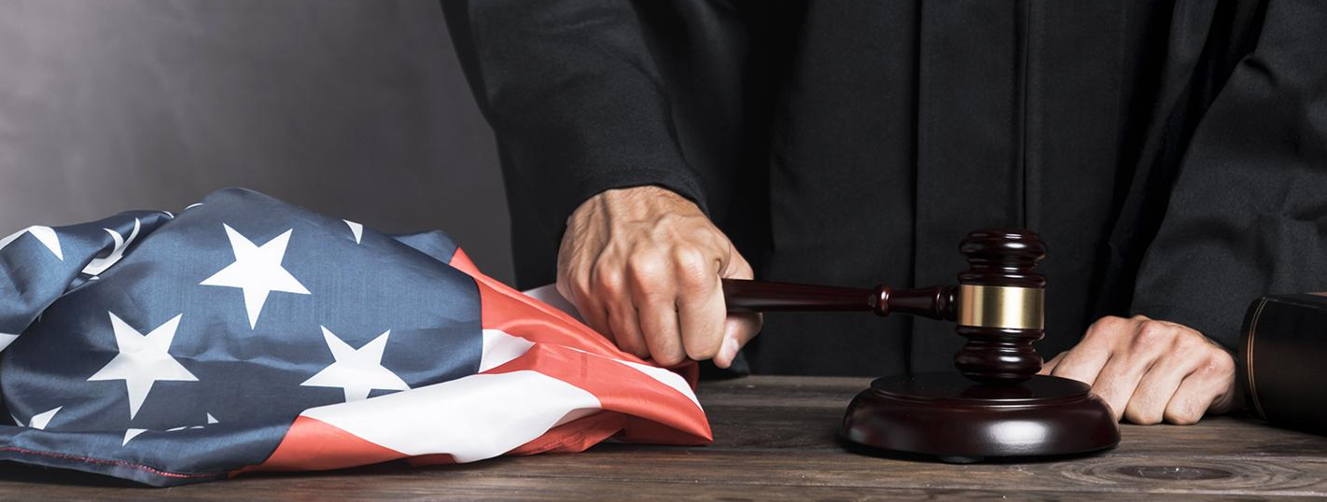
01.
POLITICAL SYSTEM
American Politics
The Democratic Republic

Slide 4
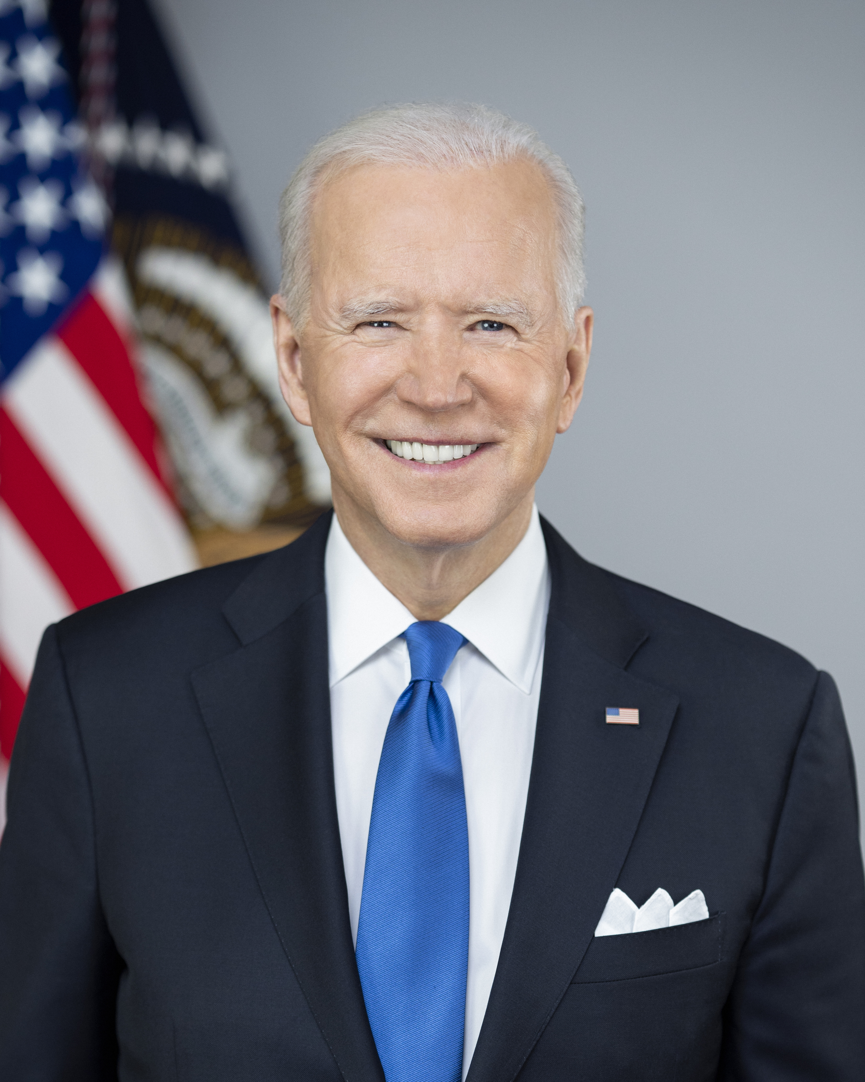
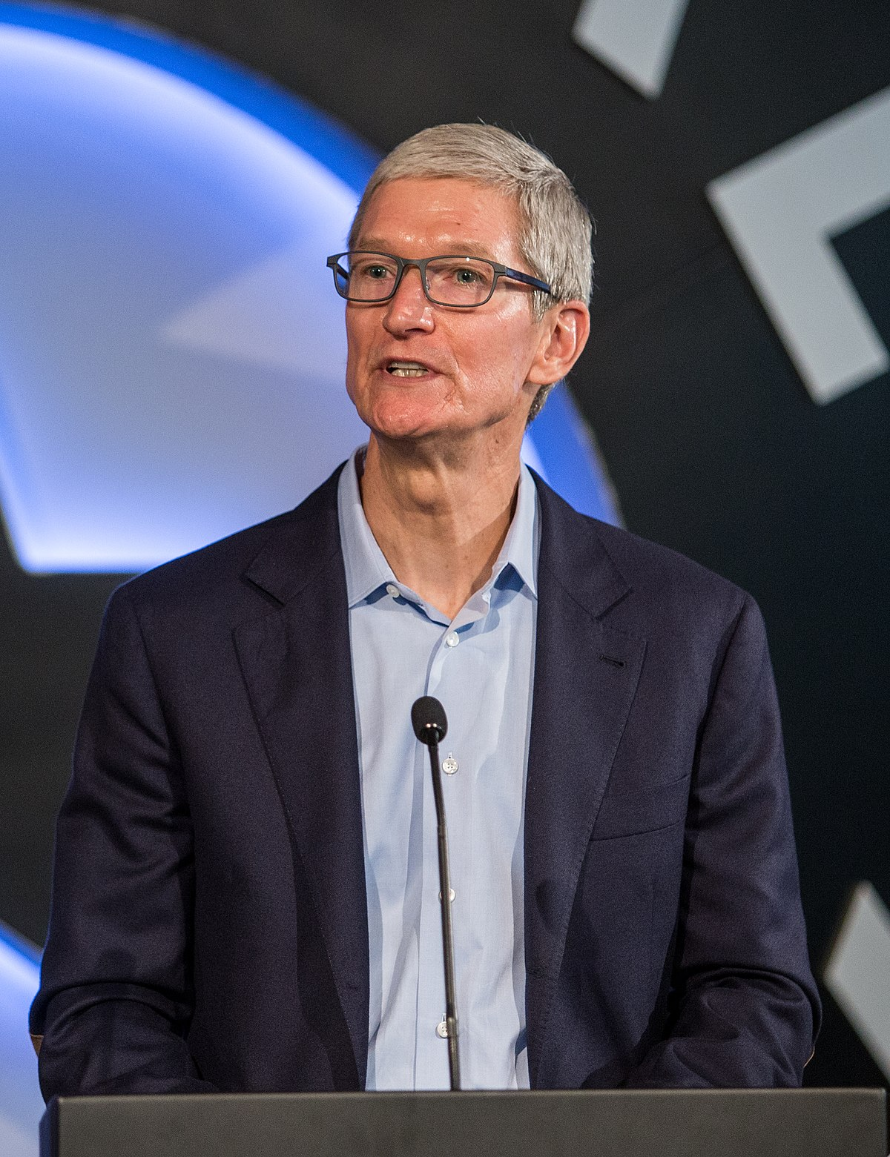
Politics Definition
American Politics
The Democratic Republic
The process of resolving conflicts and deciding “who gets what, when, and how.”
The struggle over power within organizations that can grant benefits or privileges.

Slide 5
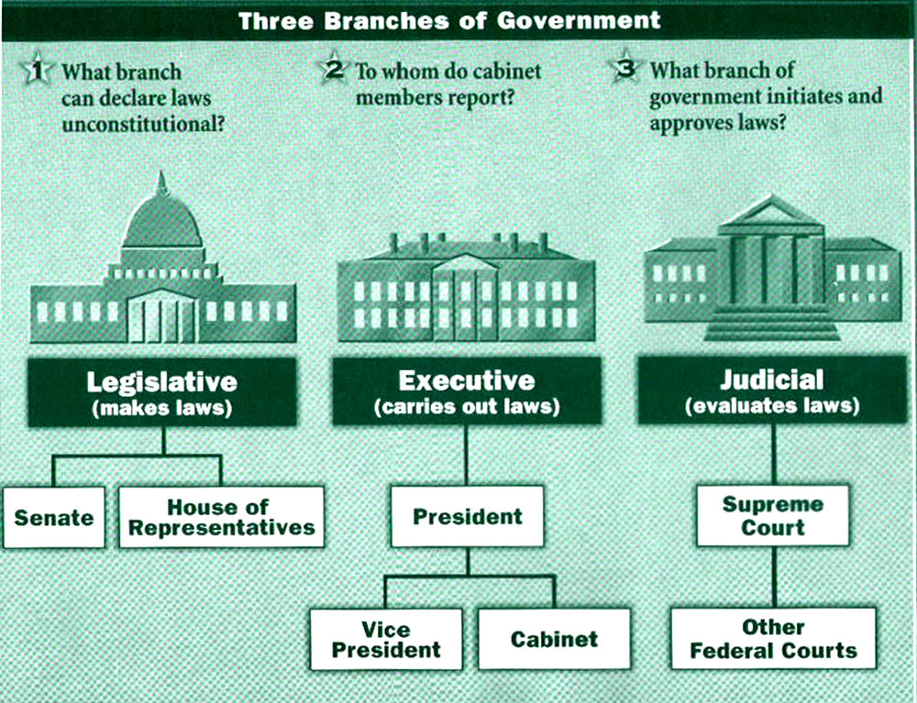
Government Definition
American Politics
The Democratic Republic
Within government, decisions are made to resolve conflicts and allocate benefits and privileges.
The preeminent institution within society
Why is it preeminent?

Slide 6
Government’s Preeminence
American Politics
The Democratic Republic
The omnipresent government
Personal ID, Study in public school, security, taxes, transportation, social welfare…
Scenario 1: no government control
Scenario 2: too much government control

Slide 7
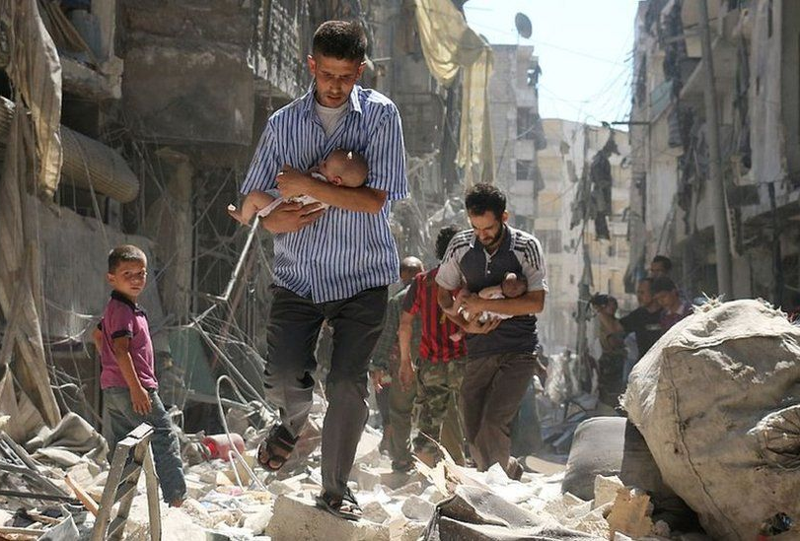
Scenario 1: No Government Control
Syria
American Politics
The Democratic Republic
2011, Assad government killed peaceful protestors
Armed rebellions
The government lost control of the country

Slide 8
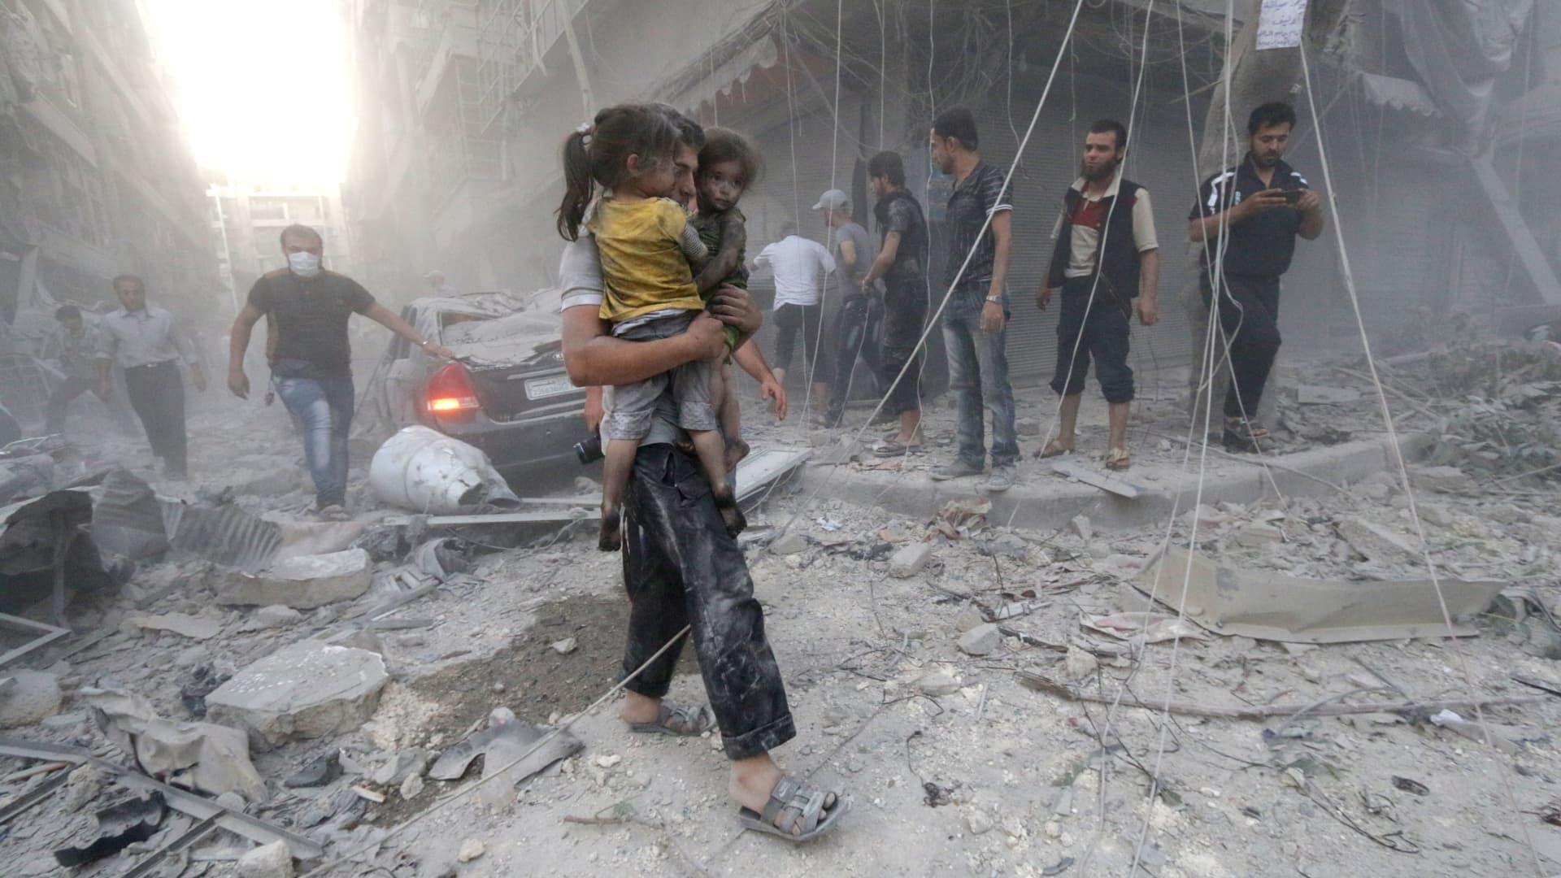
Scenario 1: No Government Control
Syria
American Politics
The Democratic Republic
Law and order had broken down completely
By 2020, up to 570,000 people had been killed, and more than half of the country’s people had been driven from their homes.

Slide 9
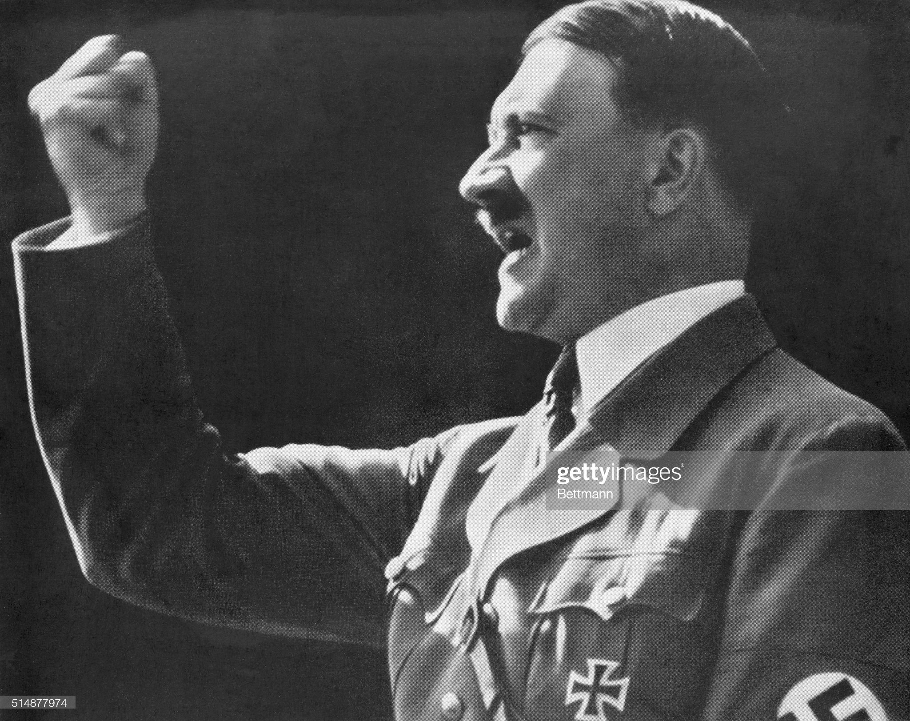
Scenario 2: Too Much Government Control
A more common case
Human rights organizations
American Politics
The Democratic Republic
Syria before the rebellions broke out
Nazi Germany under Adolf Hitler
Freedom House 2022

Slide 10
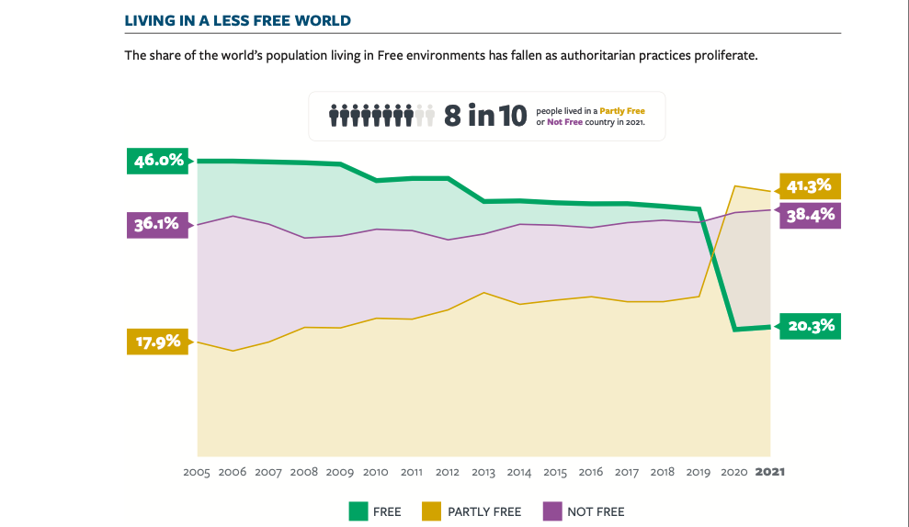
1,000,000
Big numbers catch your audience’s attention easily

Slide 11
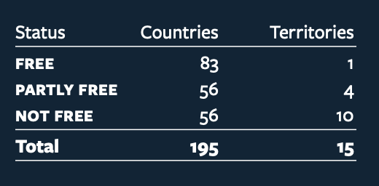
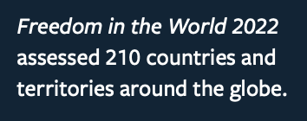
1,000,000
Big numbers catch your audience’s attention easily

Slide 12
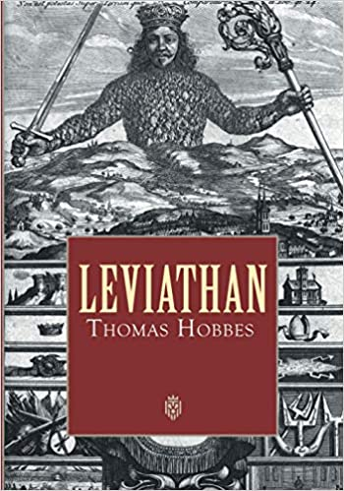
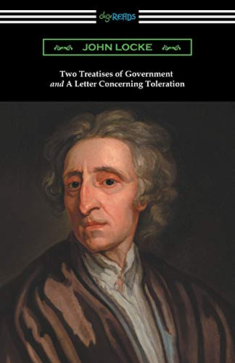
Origins of Government
Thomas Hobbes
John Locke
American Politics
The Democratic Republic
Leviathan
Realism
Two Treatises of Government
Liberalism

Slide 13
Authority
Legitimacy
American Politics
The Democratic Republic
Facilitates GOV to enforce its decisions
Based on armed forces & the police
Authority accepted-----Legitimate
Authority not accepted-----illegitimate

Slide 14
Forms of Government
American Politics
The Democratic Republic
Divided by which person or group of people controls society through the government:
Totalitarian regimes: few ctrl gov; gov ctrl all
Authoritarian regimes: few ctrl gov; gov ctrl gov
Democracies: rule by the people

Slide 15
Forms of Government
American Politics
The Democratic Republic
Direct democracy
Decisions are made by everyone directly
Ancient Greece
Representative democracy/democratic republic
Decisions are made by representatives elected by the people

Slide 16
Forms of Government
American Politics
The Democratic Republic
Direct democracy
Small communities
Demerits
The tendency for the public to be easily swayed by demagogues
The possibility for the tyranny of the majority
Serve as complements: initiatives, referenda, recalls
Representative democracy/democratic republic

Slide 17
Forms of Government
American Politics
The Democratic Republic
Direct democracy
Representative democracy/democratic republic
With or without a monarch
the people hold the ultimate power over the government through elections
Universal suffrage; majority rule; minority rights; Constitutional democracy

Slide 18
Forms of Government: Other Names
Autocracy
Monarchy
Communism
Aristocracy
Theocracy
Oligarchy
American Politics
The Democratic Republic
Rule by a dictator with no legal restraints or popular control
Rule by a dynasty; monarch sovereignty
the means of production are commonly owned and production is undertaken for use, rather than for profit.
Rule by the best/rich
Rule by God
Rule by few
(See Wikipedia at https://en.wikipedia.org/wiki/Listofformsofgovernment)

Slide 19
Theories Describing American Democracy
American Politics
The Democratic Republic
Majoritarianism
GOV does what the majority want
Not authentic description
Elite Theory
GOV does what the elites want
US a sham democracy
Pluralism
GOV does what the groups want

Slide 20
Theories Describing American Democracy
American Politics
The Democratic Republic
Majoritarianism
Elite Theory
Pluralism
GOV does what the groups want
Groups struggle for the benefits of their members
Demerits:
Poor people not represented;
Rich people overrepresented;
Strong groups’ interests win in the end

Slide 21
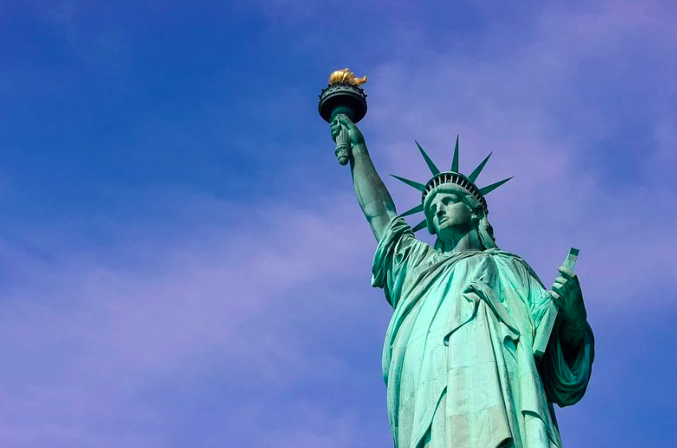
02.
POLITICAL CULTURE
American Politics
The Democratic Republic
Liberty, Order, Equality, Beliefs on the size of GOV

Slide 22
1）Liberty vs. Order
Freedom of religion
Abortion
Freedom of speech
Same-sex Marriage
American Politics
The Democratic Republic
Pro-choice?
Pro-life?
Privacy right?
A challenge to order?

Slide 23
2）Liberty vs. Equality
American Politics
The Democratic Republic
Promoting equality would limit the majority’s de facto right (freedom/liberty) to discriminate against the minority.
equality in terms of suffrage✅
equality in terms of distribution of wealth❓

Slide 24
2）Liberty vs. Equality
Property Right
Distribution of wealth
Egalitarianism
American Politics
The Democratic Republic

Slide 25
3）Small GOV vs. Big GOV
American Politics
The Democratic Republic
Americans tend to oppose big government, even though they receive benefits from it
A recent case where big government failed
Obama and the recession
Conservatives seemingly against big government but actually supporting projects like Medicare

Slide 26
3）Small GOV vs. Big GOV
American Politics
The Democratic Republic
Americans tend to oppose big government, even though they receive benefits from it
A recent case where big government failed
Obama and the recession
Conservatives seemingly against big government but actually supporting projects like Medicare
Whether to have small or big GOV
|
|
v
Whether one can benefit from GOV

Slide 27
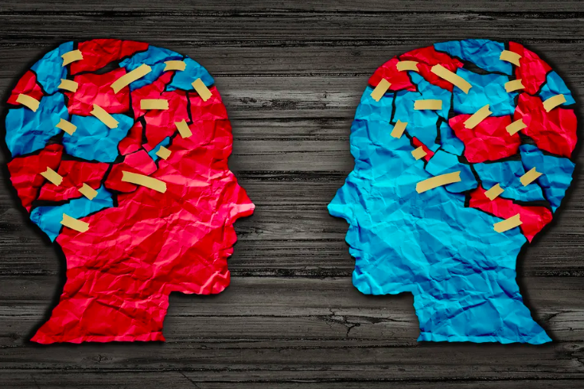
03.
POLITICAL IDEOLOGIES
American Politics
The Democratic Republic
Conservatism vs. Liberalism

Slide 28
Major Ideologies
American Politics
The Democratic Republic
 | Conservatism | Liberalism
Definition | pro (religious) tradition | against (religious) tradition
Values they support | Liberty, order, authority | Liberty, equality
Liberty meaning | negative liberty free from GOV control | positive liberty free to live one’s own values
LGBTQ and abortion | against | for

Slide 29
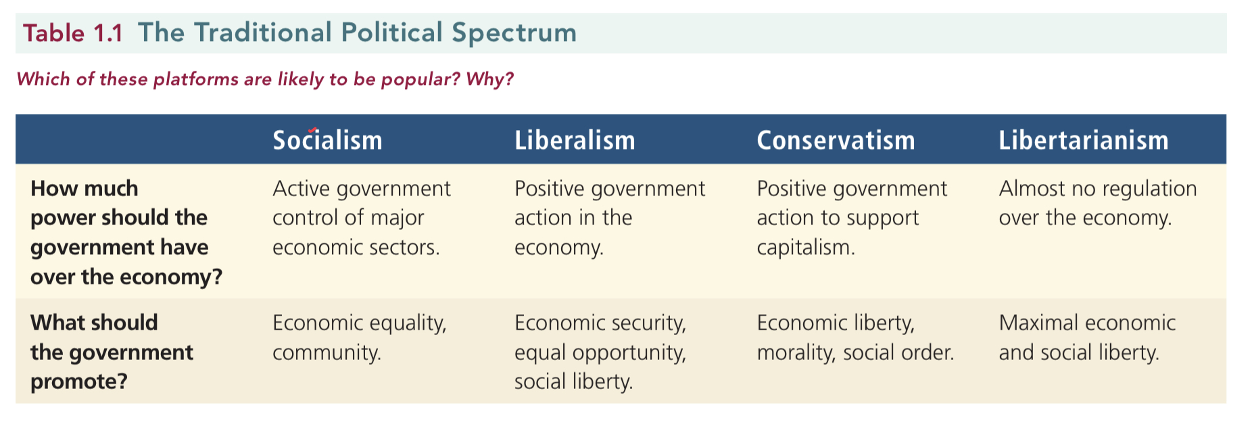
Major Ideologies: Spectrum
American Politics
The Democratic Republic

Slide 30
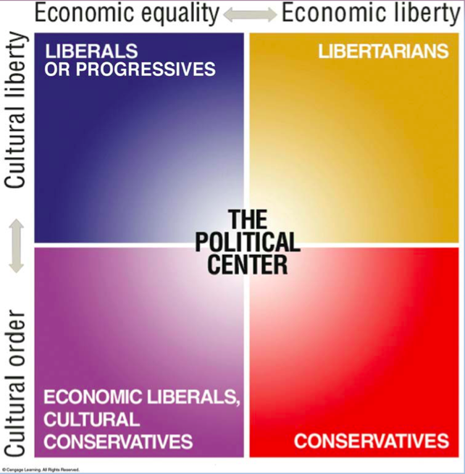
Major Ideologies: Grid
American Politics
The Democratic Republic

Slide 31
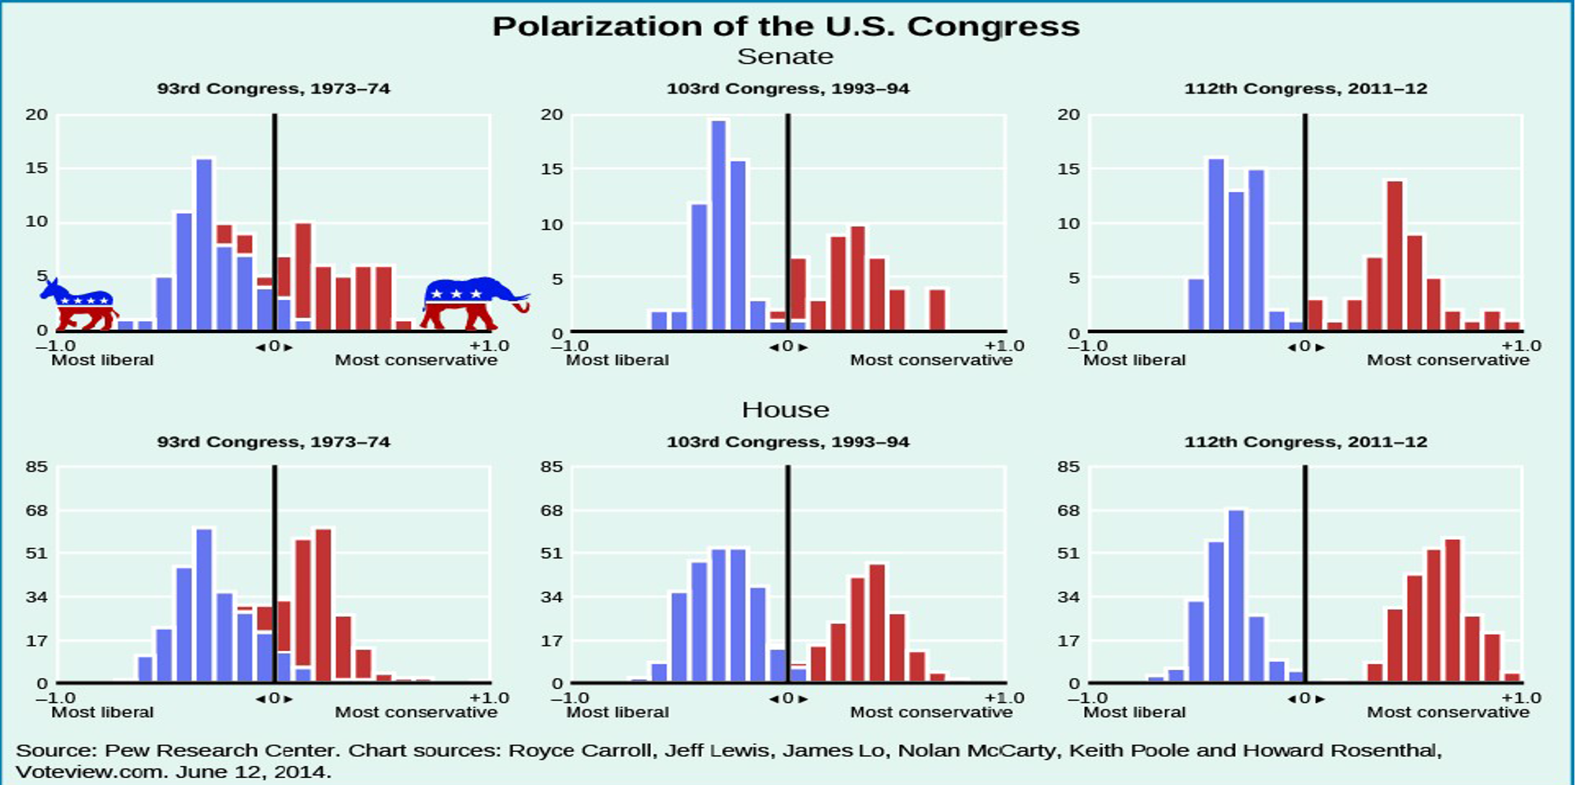
Major Ideologies: Polarization
American Politics
The Democratic Republic

Slide 32
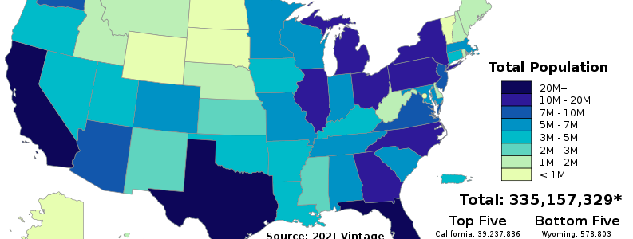
04.
US TODAY
American Politics
The Democratic Republic

Slide 33
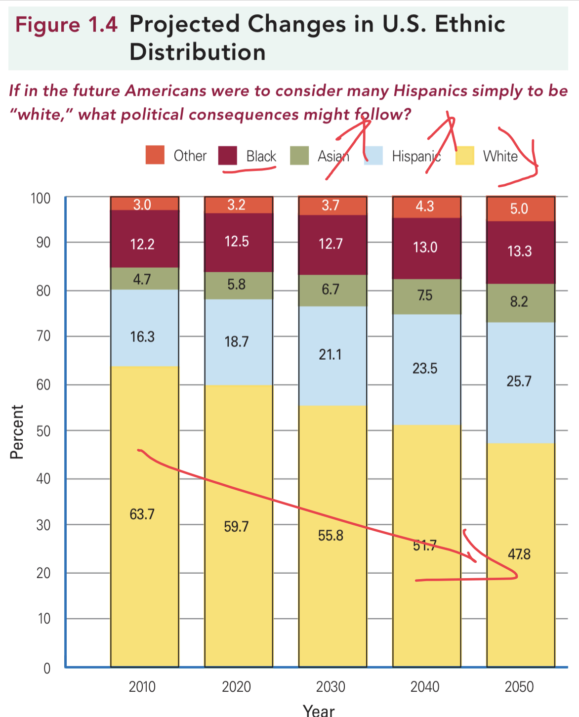
US TODAY
Population changes
American Politics
The Democratic Republic
The population explosion in America stops,
the fertility rate 2.1;
Natural birth + immigration = P
There’s an ethnic change:
Asian American and Hispanic American
White Americans are decreasing;
Political preferences for white Americans are foreseen to be shifting towards conservatism.

Slide 34
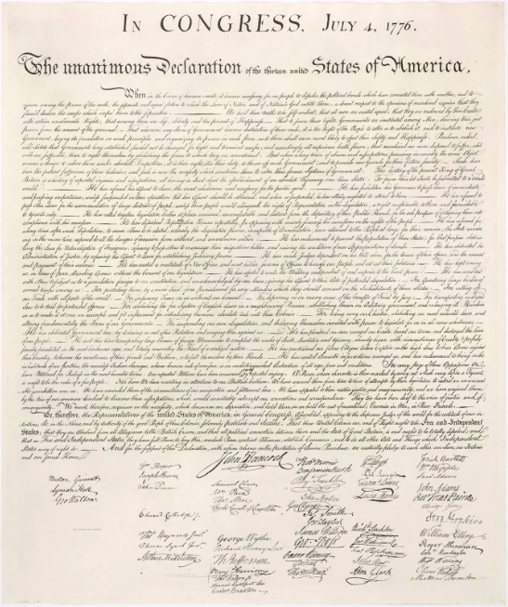
Declaration of Independence
the founding document of the United States
American Politics
The Democratic Republic
Approved by the Continental Congress on July 4, 1776
Announced the separation of 13 North American British colonies from Great Britain
Explained the legitimacy for Independence by listing the unfair treatment they receive from Britain

Slide 35
Declaration of Independence
American Politics
The Democratic Republic
“We hold these truths to be self-evident, that all men are created equal, that they are endowed by their Creator with certain unalienable rights, that among these are life, liberty, and the pursuit of happiness. That, to secure these rights, governments are instituted among men, deriving their just powers from the consent of the governed. That, whenever any form of government becomes destructive of these ends, it is the right of the people to alter or to abolish it, and to institute new government, laying its foundation on such principles, and organizing its powers in such form, as to them shall seem most likely to effect their safety and happiness.”

Slide 36
THANKS!
THE DEMOCRATIC REPUBLIC
PRESENTED BY ZHANG WEI
SEPTEMBER 7, 2022

Slide 37
REFERENCES
American Politics
The Democratic Republic
Ford, Lynne E., Barbara A. Bardes, Steffen W. Schmidt and Mack C. Shelley II. American Government and Politics Today, enhanced 20th ed., Cengage, 2022.
Freedom House. Freedom in the World 2022. https://freedomhouse.org/sites/default/files/2022-02/FIW_2022_PDF_Booklet_Digital_Final_Web.pdf
David B. Magleby & Paul C. Light & Christine L. Nemacheck. Government By the People, 2016 Presidential Election Edition.
The Declaration of Independence

